Slide 1
Workflow Engine Service MWF Integration
Jumbo Yang

Slide 2
What is MWF
MWF: Myworldflow (http://www.myworldflow.com)
A Workflow Engine runs in the cloud as a service, no local installation is required.
Can be used remotely to drive either human-oriented workflow or computer-oriented business process.
Business data is kept on local side
Provide Restful API, and GUI workflow designer, can be integrate into any application with any modern language.

Slide 3

How to use MWF
Your Application
MyWorldflow
Workflow as a Service
Restful API
ERP
Enterprise Application
Restful API
CRM
Mobile
Application
Restful API
Internet
Application
MWF is running in the cloud, it take the role as a workflow driver only while you can keep business data in your own business boundary securely.

Slide 4
What you can do with MWF API
Start a workflow
Get user’s work list, get a work item
Finish a task with user input
Integrate with other application by Java or Web services written in any language.
Get and modify workflow process contextual values
Check workflow status
…

Slide 5
How to design workflow template
MWF provides a WYSIWYG GUI workflow template designer.
You may use it on MWF demo site.

Slide 6
Scenario: Vacation Application
Employee apply vacation leave.
Manager approve the application
If the application is rejected, employee have the opportunity to re-apply.
The same workflow can be used by anyone, but the approver is different, in department A, the approver is Mr. John, in department B, the approver is Mr. Smith.

Slide 7
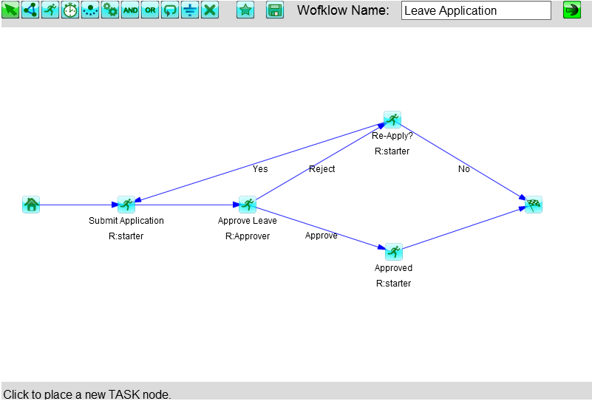
Workflow Template Design
In myworldflow, design a workflow template like this

Slide 8
Create teams for different department
String teamA = client.createTeam(accessKey, “departmentA”, “team of department A”);
String teamB = client.createTeam(accessKey, “departmentB”, “team of department B”);

Slide 9
Add team members
JSONObject mbrsA = new JSONObject();
mbrsA.put(“john”, “Approver”);
client.addTeamMembers(accessKey, teamA, mbrsA.toJSONString());
JSONObject mbrsB = new JSONObject();
mbrsB.put(“smith”, “Approver”);
client.addTeamMembers(accessKey, teamB, mbrsB.toJSONString());

Slide 10
Start the workflow for TeamA
String prcid = client.startWorkflow(accessKey, “MYUSRID", “WORKFLOW_TEMPLATE_ID”, teamA, "testProcess_5");
//Replace MyUSERID with the current userid.
//Replace WORKFLOW_TEMPLATE_ID with the id of previously created workflow template

Slide 11
Scenario: Quality Check
Goods entering warehouse by batch.
Quality check is required but not for every batch, but only when the number of items is more than 500.

Slide 12
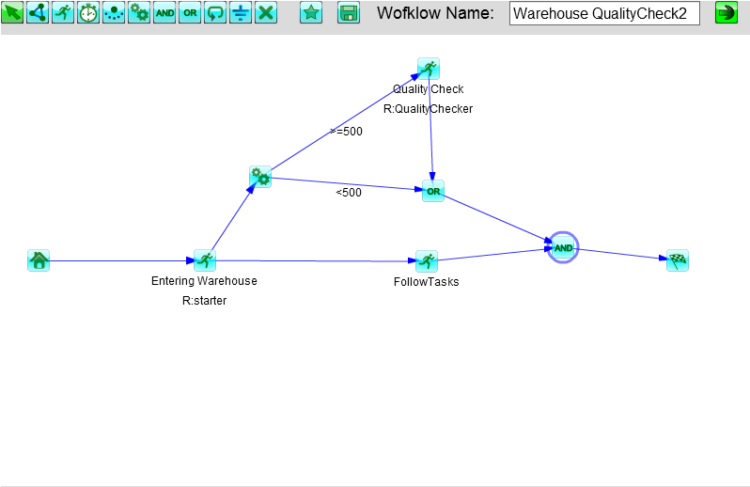
Workflow Template Design

Slide 13
References
My World Flow Tutorials
http://www.myworldflow.com/cflow/tutorial/videos.htm
http://www.myworldflow.com/cflow/tutorial/help_and_tutorials.html

